Slide 1

Identifying At-Risk Patients
Presented by:
Jennifer Sullivan Nate Evans
Lily Cook
Notes:
Lily will introduce the project and do slides 1-4
Nate will discuss slides 5-6
Jennifer will do slides 7-8

Slide 2
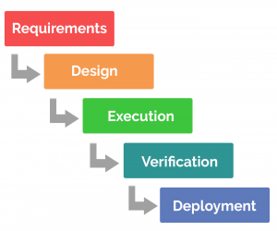
Overview
But how can we argue for deployment if we don’t understand the requirements?
In this class, we’ve primarily focused on these components of a project, with emphasis on LACE model development.
This presentation is an opportunity to argue for the value of our models performance.

Slide 3
Overview
In this presentation, we’ll…
Outline the critical need motivating this project
Review our preliminary model development
Discuss application, interpretability and value of our model
Take a step back and ask, what is the value of implementing THIS model?
And how do we make a data-driven decision?
Notes:
We are asking for more resources to continue to hone the model so we can reduce readmissions. for patient health and maximizing reimbursement (avoid penalties) means a better allocation of resources.
Briefly introduce the concept
“Over the next 15 minutes I will introduce a risk score that will help us predict the risk of inpatient readmissions. I will lay out the need for change, introduce you to the model, and discuss how you will play a role in the success of this effort.”
I frequently see analysts spend too much time setting the stage and defining the need for change (next section). Do not fall into this trap. You will run out of time and lose your opportunity to explain the model and how it will help!
Let people know what we are there for, and what we want them to do. Delicate balance between not providing enough context and spending too much time here (and thereby not leaving enough time for the remainder of the presentation – the MEAT of the issue

Slide 4
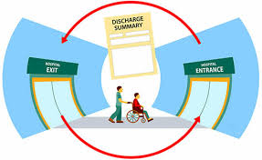
Why change?
Currently there are no clinical tools for robust readmissions predictions ; Physicians are only correct 40% of the time.
Hospital readmissions are currently costing us $1 million in lost Medicare revenue.
Highest-risk patients are 5% of our patient population, but 80% of our treatment cost.
Notes:
Make progress on risk stratification,
[choosing a cutoff for sensitivity and specificity]
Spend a few minutes establishing a fact based need for change. Use existing organizational performance metrics, published studies, and current organizational problems to frame the need for change. Do not introduce editorial or build connections to the future yet. You are using facts to explain the current state.
Again, spending too much time justifying the need for change is the most common analyst presentation trap I witness! Your audience already knows the problems if they work inside the organization. Use this to pinpoint which specific pain points your model will help address.
Think about how we are going to measure the return on investment.

Slide 5
Impact of not changing
Our population is aging
Reactive, not preventive
As we transition away from fee-for-service model, penalties for missed benchmarks will increase
Lower quality of life for patients at the end-of-life
Notes:
Possibly: case study of a particular patient; or a testimonial? Currently transitions of care are the most dangerous time for patients…. Number of medical errors, such as med reconciliation errors.
Build the connection between inaction and the future state with a focus on building the emotional connection to the need for change. Connect current problems to likely / plausible future consequences. patient testimonial

Slide 6
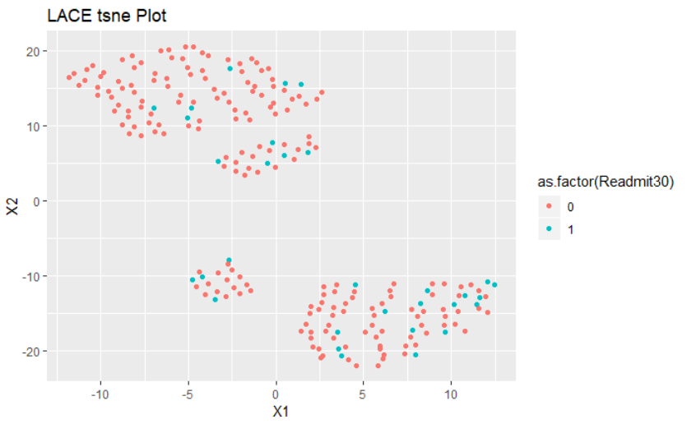
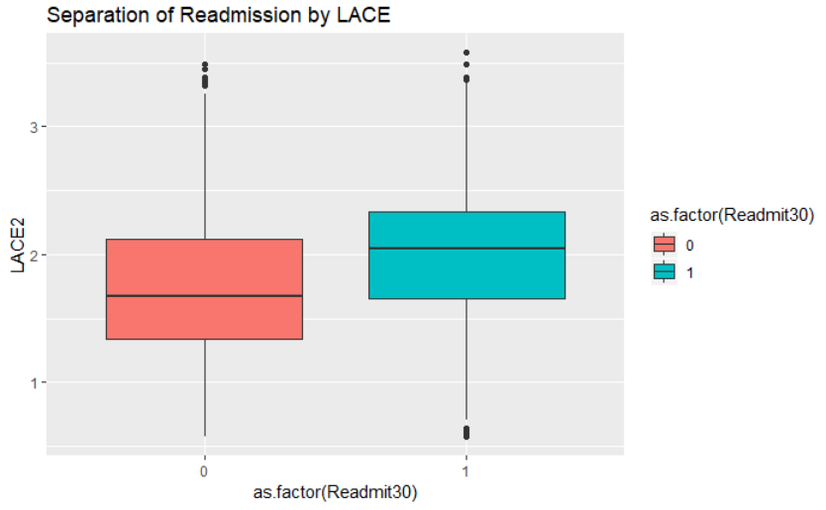
Preliminary Model Development
Logistic Regression
Exogenous Features: LACE metric
(Ottawa Hospital Research Institute LACE Index Scoring Tool for Risk Assessment of Death and Readmission)
Notes:
Increase accuracy of predictive power. More time for development to increase predictive power and boost performance. Those resources should be dedicated to testing additional features/variables.
Explain the solution at a high level before going into detail – i.e., broad explanation, tie it t a workflow, how it is a transitional model, (DON’T define what the acronym LACE means, but how it’s implementation will be used w/in the organization. Make it a well-told story.
Skipping the high level and jumping straight to the detail is the second most frequent analyst presentation mistake I see. Give your audience the big picture first so they can better understand and relate to the component parts. This will save you from interruptions and increase their understanding.
The bulk of your presentation should focus on the solution (this section plus the next two)

Slide 7
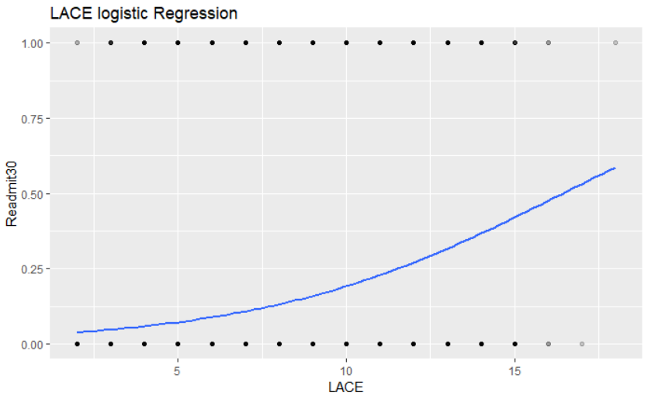

Preliminary Model Development

Slide 8
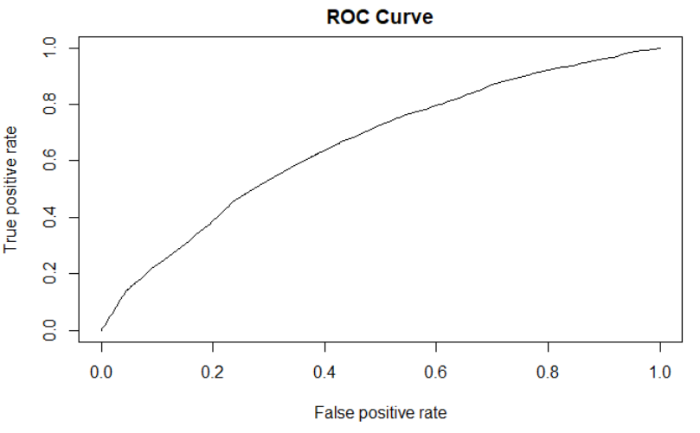
Preliminary Model Development
AUROC
0.66
Threshold [Ideally] chosen by maximizing Youden’s index (Sensitivity + Specificity – 1)
Threshold = 0.2 | Number
Correctly Predicted Readmissions (TP) | 2019
Incorrectly Predicted Readmission (FP) | 5986
Correctly Predicted Non-readmission (TN) | 22864
Incorrectly Predicted Non-readmission (FN) | 3025

Slide 9
What is good enough?
Cost-Benefit Analysis – Rshiny App

Slide 10
Applications of the Project
Accurate risk stratification
Anticipated increase in the accuracy of risk prediction to 80% (physician estimate is 40% accurate; current model is 66%)
Early identification means timely intervention
Targeted transition plans = Improved patient choice and better quality of life
Transition of care team
Incorporate information into discharge orders
Referrals to palliative care, case management, MA check-ins
Financial benefits
Anticipated reduction of readmissions: 25%
Recoup investment w/in: 6 months
Automated score w/in the EHR= low maintenance costs
Notes:
Our group:
We will be better able to identify and target high risk patients. This may mean referring these patients for case management, follow-up calls and in-home visits, and referrals to palliative care. This will increase our Medicare reimbursement by $______ (dollar amount), because readmissions will be reduced by ____ amount. Triple AIM: . Users will be the transition team,
Increases physician ability to accurately risk stratify patients from 40% to 80%, has an education value to training
Rollout, impact, how it will fit w/in workflow, how it will be implemented, where it will be, how it will be used clinically. How long it will take to implement and how long it will take before it returns value, how it will continue to work over time.

Slide 11
Your Role / Sponsorship
Corporate backing
Resources
Access to information
Age
Gender
Pharmacogenomic data
3 FTE for 3 months
Notes:
Our group(???): Authority to roll out a larger implementation, and resources (dedicated time, money, staff/people power) and their backing as a champion of the project.. Give them something PHYSICAL and TANGIBLE they can pass along to others. Keep in mind that the presentation should be comprehensible even by someone who didn’t attend the presentation, because it may be passed around w/in the organization. Access to this specific data, this specific amount of time, this amount of money and FTE.
End with action!
Specifically detail what you need your audience to do in order to make this effort a success.
Think of this as the positive benefits that offset the negative consequences you highlight earlier.
Leave your audience with a clear sense of what they need to do individually to drive success when the leave the room.

